Slide 1
Fast-Transient Low-Dropout Regulator

Slide 2
Fast-Transient Low-Dropout Regulator

Slide 3

Main Points
Introduction
Design specs
Design methodology
Simulation results
Design challenges
10 September 2024

Slide 4
Introduction
Who are we
Our goals Robust power management unit
What is an LDO
Is it really an LDO?
10 September 2024

Slide 5
Design Specs
10 September 2024

Slide 6
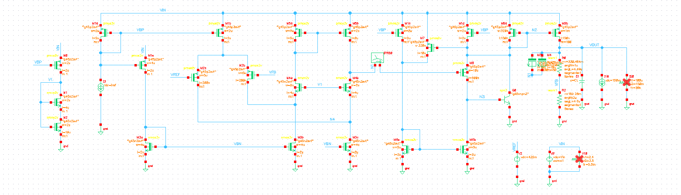
Design Methodology
LDO Topology
We want a stable fast-transient topology
Error Amplifier’s Topology
How is the input and output’s swings?
10 September 2024

Slide 7
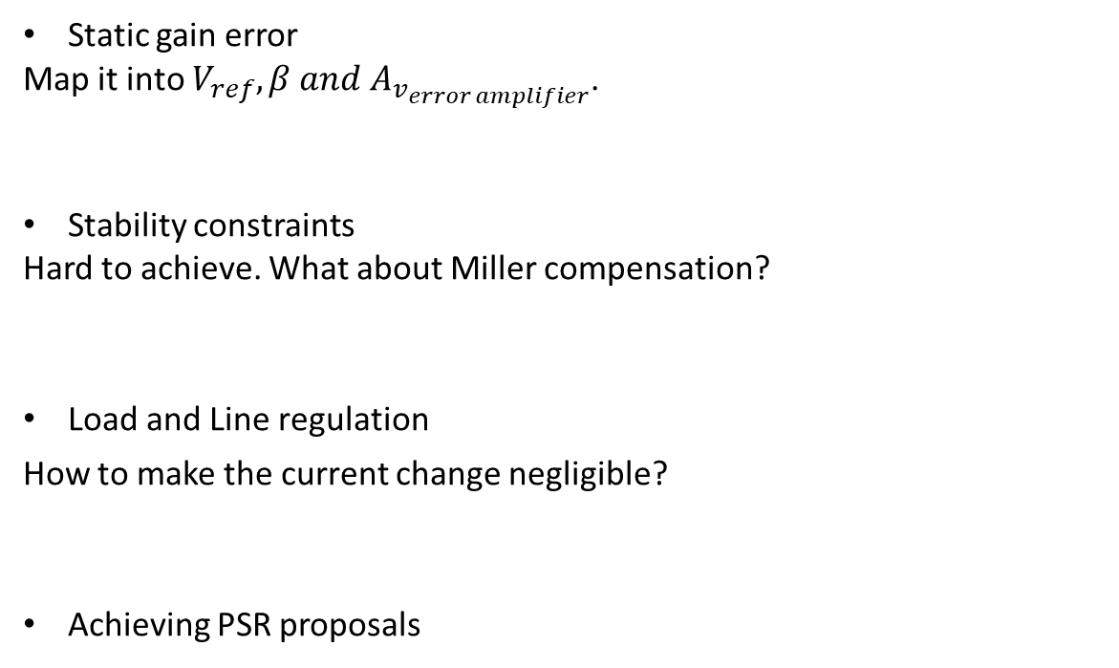
Design Methodology
Static gain error
Map it into $V_{ref}, β and A_{v_{error amplifier}}$.
Stability constraints
Hard to achieve. What about Miller compensation?
Load and Line regulation
How to make the current change negligible?
Achieving PSR proposals
10 September 2024

Slide 8
Simulation Results
DC operating parameters simulation
Transient load simulation
Transient input simulation
Stability analysis and PSR
Figure of merit
Specs achieved
10 September 2024

Slide 9
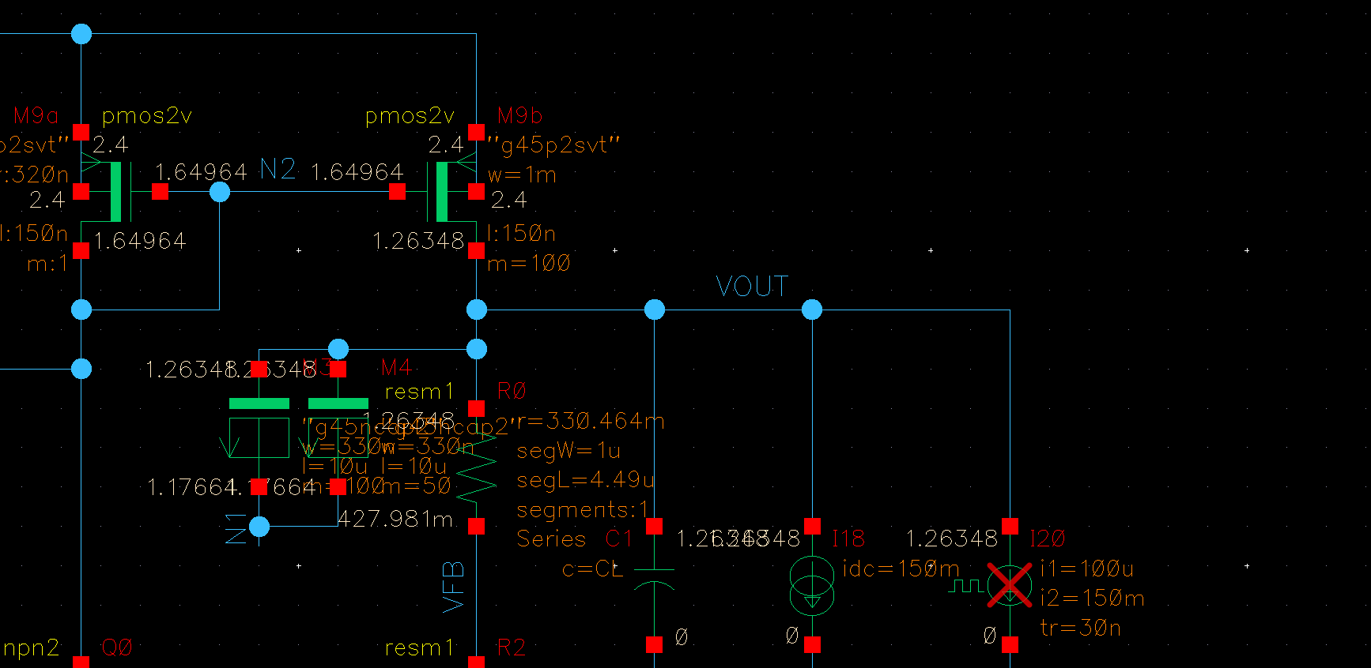
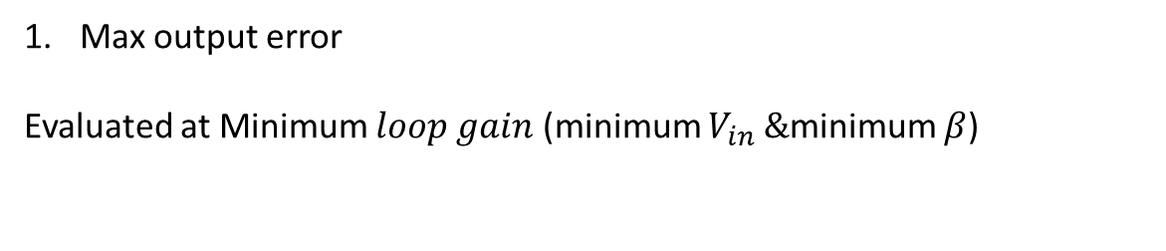
DC OP Simulation
Max output error
Evaluated at Minimum $loop gain$ (minimum $V_{in} \&$minimum $β$)
10 September 2024

Slide 10
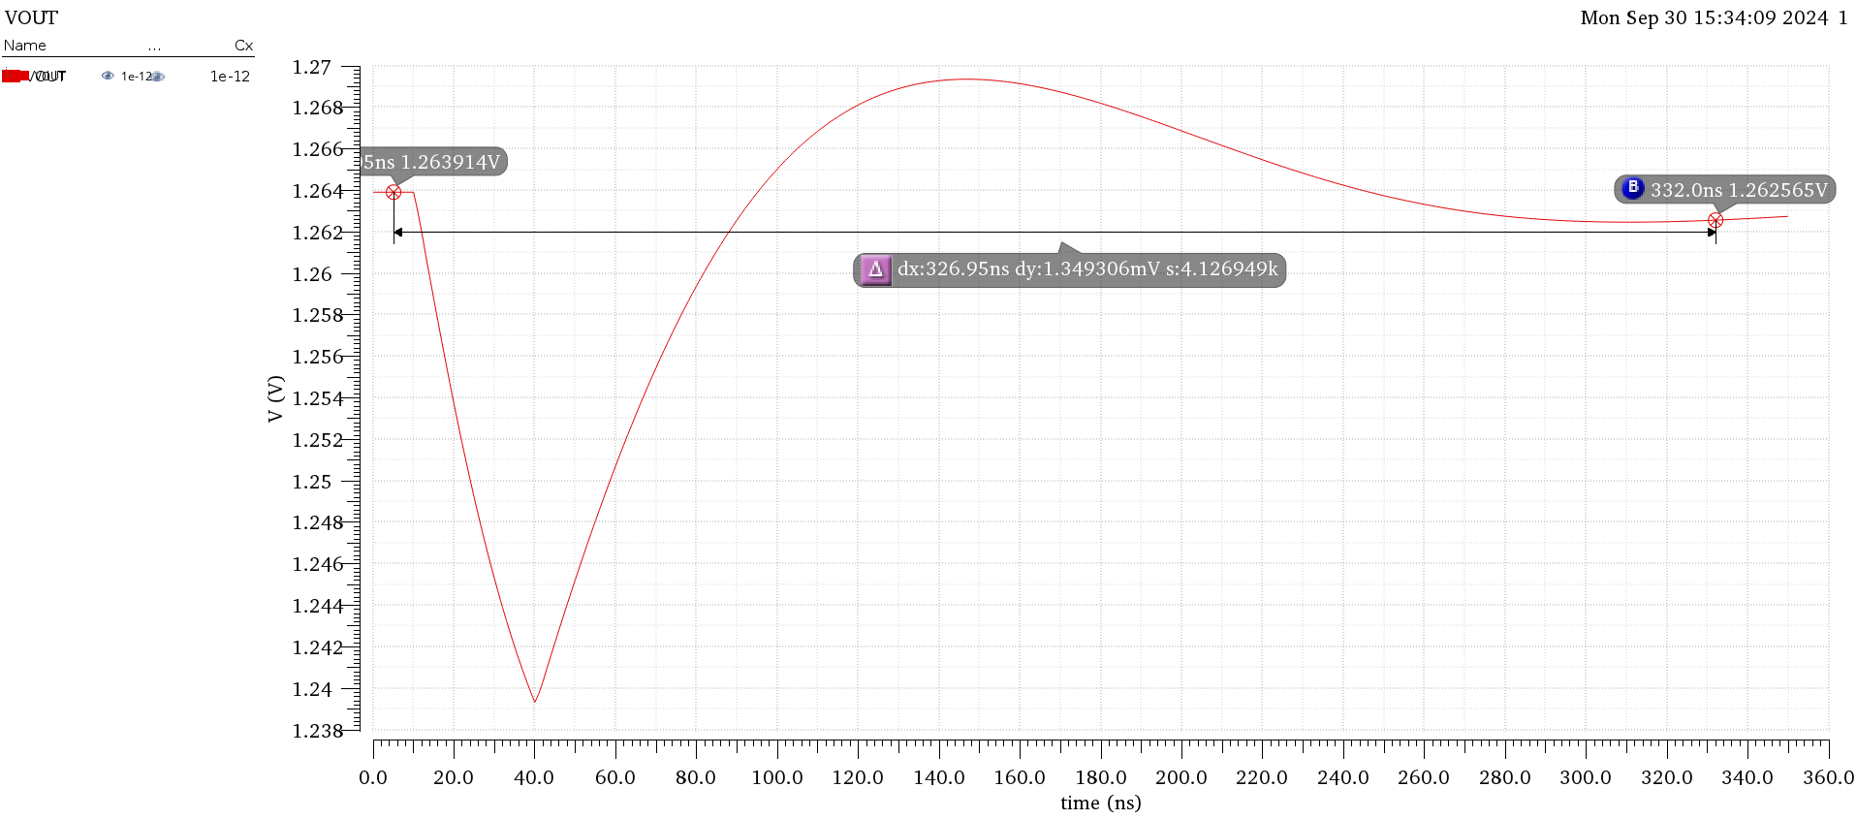
Transient Load Simulation
Load regulation
10 September 2024

Slide 11
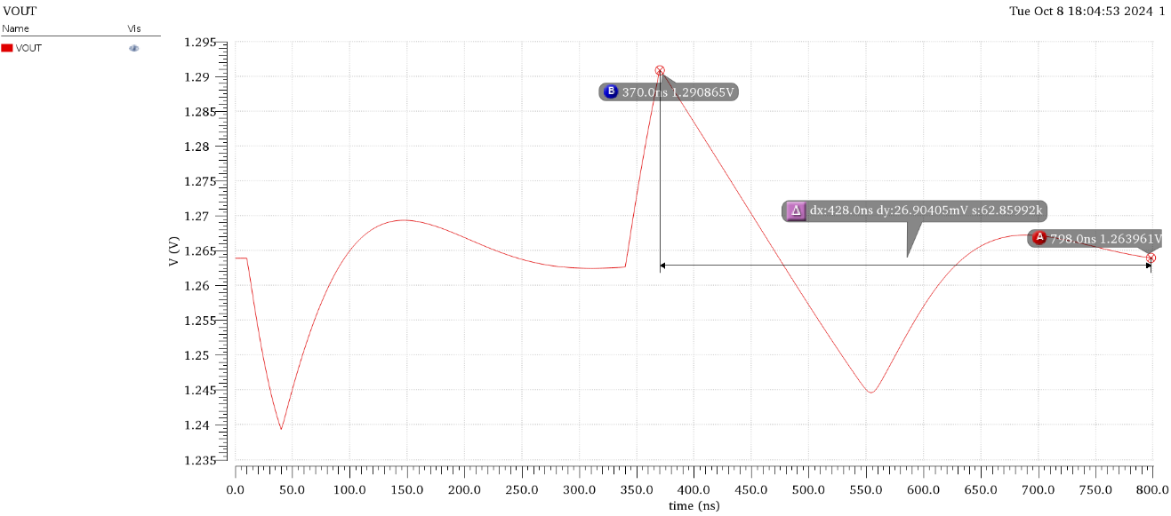
Transient Load Simulation
Load regulation
Overshoot
10 September 2024

Slide 12
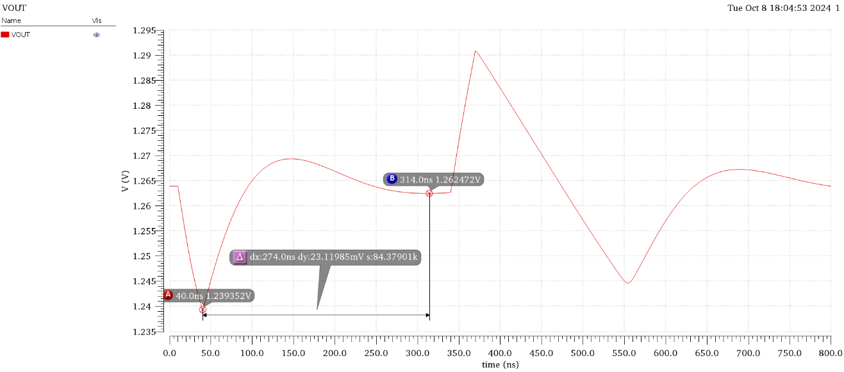
Transient Load Simulation
Load regulation
Overshoot
Undershoot
10 September 2024

Slide 13
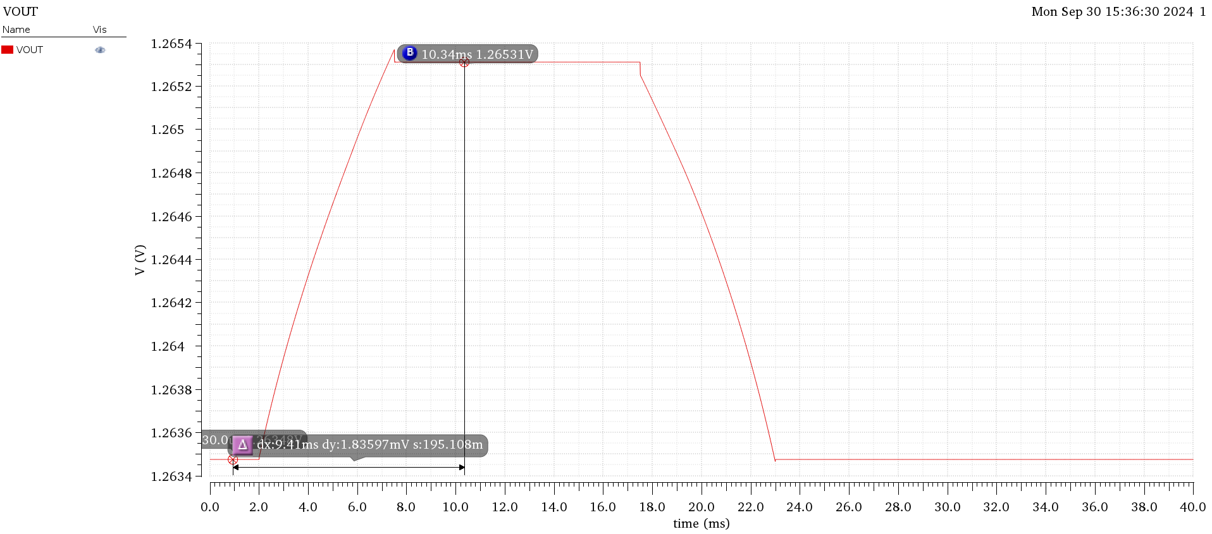
Transient Load Simulation
Line regulation
10 September 2024

Slide 14
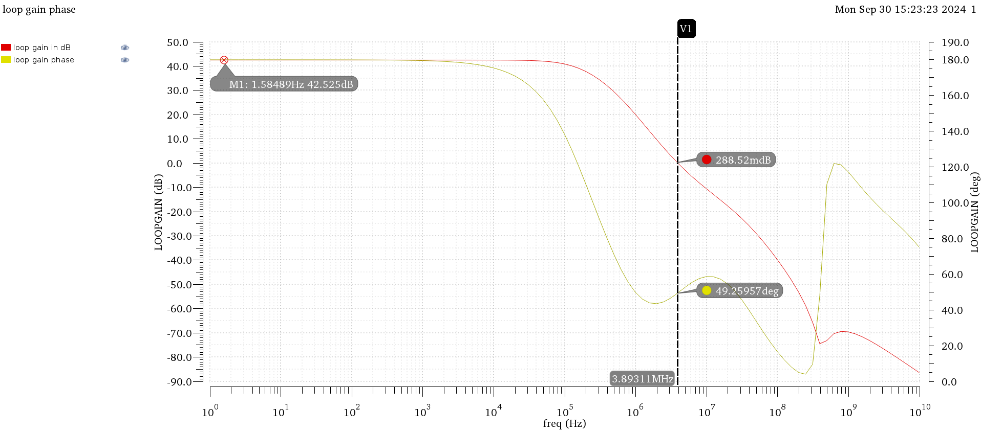
Stability Analysis and PSR
Phase Margin
10 September 2024

Slide 15
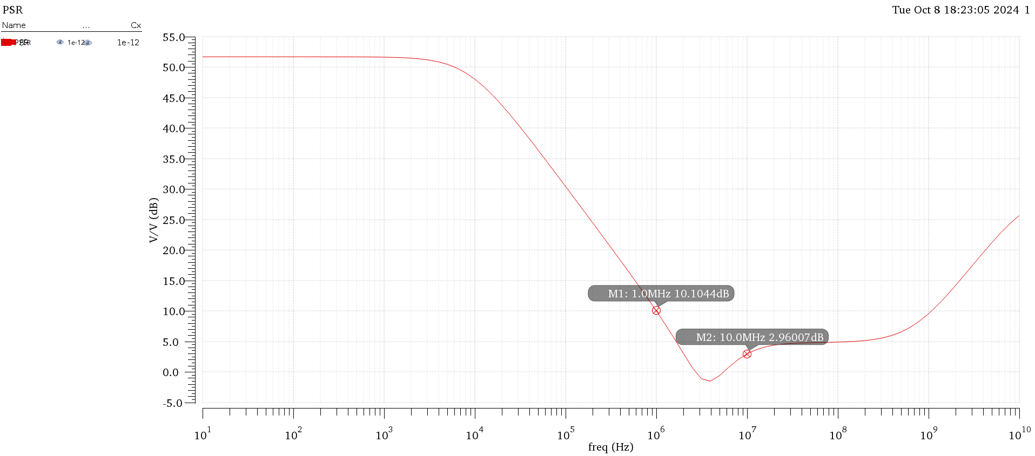
Stability Analysis and PSR
Phase Margin
PSR
10 September 2024

Slide 16
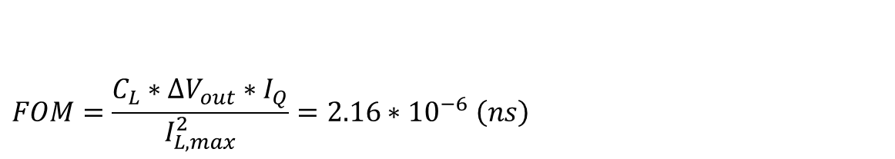
Figure of Merit
$$FOM=\frac{C_{L}∗ΔV_{out}∗I_{Q}}{I_{L,max}^{2}}=2.16∗{10}^{−6} \left(ns\right)$$
10 September 2024

Slide 17
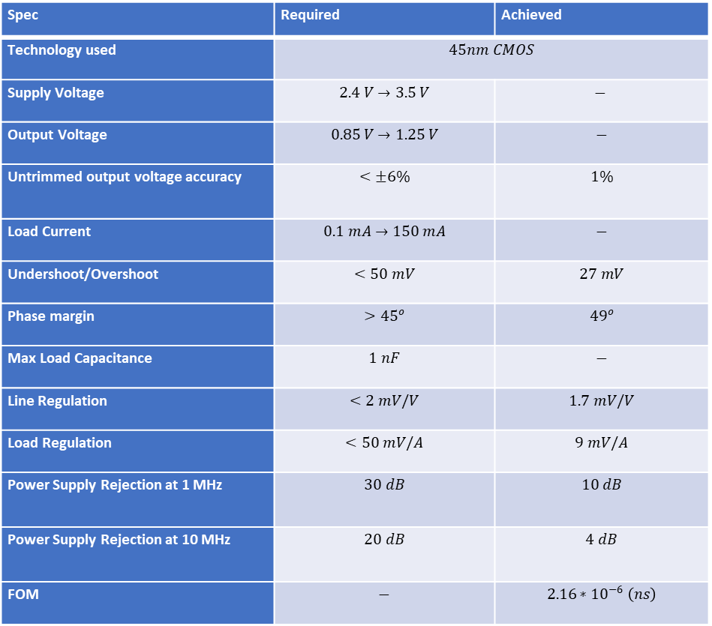
Achieved Specs
Spec | Required | Achieved
Technology used | $$45nm CMOS$$
Supply Voltage | $$2.4 V→3.5 V$$ | $$−$$
Output Voltage | $$0.85 V→1.25 V$$ | $$−$$
Untrimmed output voltage accuracy | $$<±6\%$$ | $$1\%$$
Load Current | $$0.1 mA→150 mA$$ | $$−$$
Undershoot/Overshoot | $$<50 mV$$ | $$27 mV$$
Phase margin | $$>{45}^{o}$$ | $${49}^{o}$$
Max Load Capacitance | $$1 nF$$ | $$−$$
Line Regulation | $$<2 mV/V$$ | $$1.7 mV/V$$
Load Regulation | $$<50 mV/A$$ | $$9 mV/A$$
Power Supply Rejection at 1 MHz | $$30 dB$$ | $$10 dB$$
Power Supply Rejection at 10 MHz | $$20 dB$$ | $$4 dB$$
FOM | $$−$$ | $$2.16∗{10}^{−6} \left(ns\right)$$
10 September 2024

Slide 18
Design Challenges
PSR Bypass device length, low-pass filter and El-Nozahy’s paper
Load regulation Magical mismatch effect
Line regulation Decrease the bypass current change
10 September 2024

Slide 19
Thank You
Presented by:
Mohamed Essam
Bilal Ramadan
Abdelrahman Abohendy
Mahmoud Saker

